Slide 1
Predictive Analytics For Agricultural Investments: Enhancing ROI And Mitigating Financial Risks For Farmers
Presented By:
Harsha Keladi Ganapathi
Kranthi Swapna Garapati
Sharath Chandra Kamuni

Slide 2
Problem statement
Investment and financial management challenges
Importance of Financial Planning
Lack of Investment Awareness
Uncertainty in ROI
Risk Assessment

Slide 3
Introduction:
Objective: This project aims to provide actionable insights regarding investment, ROI, and financial risk to farmers through a data-driven approach.
Target Audience
New Farmers: Individuals starting their agricultural journey without prior cultivation experience.
Experienced Farmers: Those with historical data from previous harvests, seeking to optimize their investment strategies.

Slide 4
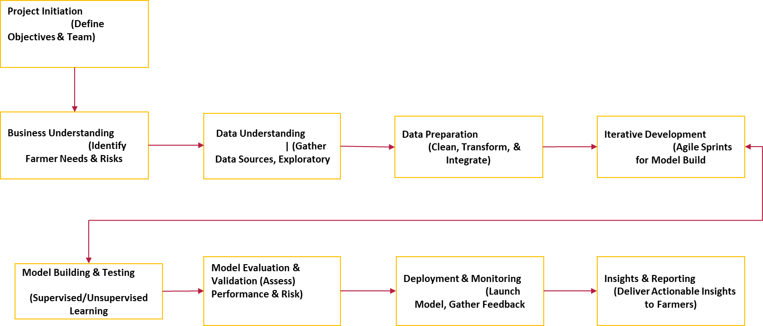
CRISP-DM with Agile Framework Flowchart

Slide 5
Data Ingestion
Data Cleaning
Data Transformation
Predictive Modelling
Insights And Recommendations
Output Visualization
Feedback Loop
Proposed Methodolgy

Slide 6
Data Sources:
National Agricultural Statistics Service (NASS) in the USA
Ministry of Agriculture and Farmers' Welfare in India.
Other relevant governmental agricultural research institutes.
Weather API
Agricultural dataset (Kaggle)

Slide 7






Tools and Technologies planning
Data Collection
Data Storage
Data Processing & Cleaning
Data Transformation
Data Visualization
User Interface

Slide 8

Thank you
Any Questions

